Slide 1
CyberPunk
Greetings!
What is it?
Demo
Discussion
A cybersecurity learning platform that combines interactive games with secure authentication and admin oversight.
The Problem
The solution & Impact
Feasibility
Design/UX (Live Demo)
TechStack & Build Process
Gamification
Teamwork
Members
Tebatso
Sabira

Slide 2
The lack of basic knowledge of cyber security leads to:
The Problem
Phishing attacks
Weak passwords
Data leaks
Traditional learning is:
Boring
Not engaging
1

Slide 3
The Solution
CyberPunk is a gamified cybersecurity learning platform that teaches users how to:
Detect phishing emails
Create strong passwords
Practice safe online habits— All through interactive games and daily challenges The app itself is safe learning — with real security features like MFA, activity logs, and role-based access.
2

Slide 4
Feasability
Area | Tool | Feasibility
Frontend | React | Fast dev, responsive UI, beginner-friendly
Backend | Express.js | Lightweight, scalable, well-documented
Database | MongoDB | Easy setup, supports user activity logging
Dev environment | Visual Studio Code | Local dev speed + Linux compatibility
3

Slide 5
Tech Stack & Build Process
Modern & Scalable Architecture: Built with the MERN Stack (MongoDB, Express.js, React, Node.js) for a full JavaScript, component-based application.
Secure by Design: Features JWT authentication, role-based access control (Admin/User), and secure environment variable management.
Streamlined Development: Utilizes npm scripts for a consistent and easy build process across all environments.
Quick Setup: A single npm install command in the /backend and /frontend directories gets the project ready to run.
4

Slide 6
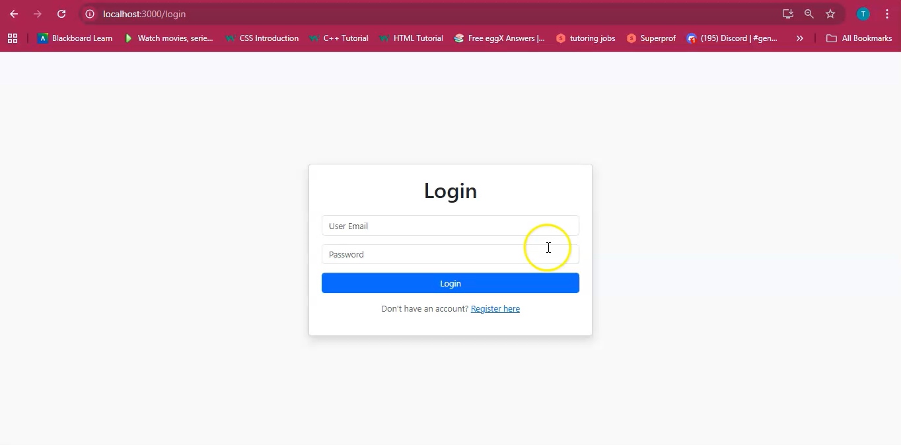
Videos

Slide 7
Gamification & Engagement
Gamification
Learning Through Play: Interactive challenges like the Phishing Simulator and Password Strength Tester turn critical security concepts into engaging games.
Motivation & Reward: A points-based Leaderboard incentivizes users to complete tasks and strengthen their security habits (e.g., enabling MFA).
Reinforced Knowledge: Daily Quizzes provide bite-sized lessons to consistently build and test users' cybersecurity knowledge over time.
Safe Environment: Users learn to spot threats and build strong passwords in a controlled, risk-free platform.

Slide 8
Teamwork
Three Musketeers: A collaborative team from the University of Pretoria, leveraging diverse skills for a unified goal.
Specialisation:
Tebatso: Backend & DevOps - Engineered the secure API, database, and project infrastructure.
Sabira: Frontend Development - Crafted the intuitive and responsive user interface.
Langazelelwa: Presentation & Strategy - Focused on effectively communicating our project's value and vision.
Agile Collaboration: Used GitHub for version control and maintained clear communication to ensure a cohesive and functional final product.
Thank you!

